Slide 1
PyTorch Distributed and Parallel Training - 1
20230405
박현우

Slide 2
Table of Contents
Overview of Distributed Training
Collective Communications
DistributedDataParallel (DDP)
Fully Sharded Data Parallel (FSDP)
RPC-based Distributed Training
PyTorch Distributed Training Best Practices
Integration with other optimization strategies

Slide 3
Overview of Distributed Training
Main components of torch.distributed
Basic Modules for Data-Parallel training in PyTorch
Main Paradigms of Distributed/Parallel training
Summary

Slide 4
1.1 Main components of torch.distributed
Features in torch.distributed can be categorized into three main components (i.e. low-level Building blocks):
Distributed Data-Parallel Training (DDP)
ProcessGroup Backend (RPC)
Collective Communication (c10d) library

Slide 5
1.1.1 Distributed Data-Parallel Training (DDP)
Aligned for single-program multiple-data training paradigm.
DDP
takes care of gradient communication to keep model replicas synchronized (c.f. complete model replication of DP)
and overlaps it with the gradient computations to speed up training.

Slide 6
1.1.2 ProcessGroup Backend (RPC)
Aligned for supporting general training structures beyond data-parallel training, such as
distributed pipeline parallelism,
parameter server paradigm,
and combinations of DDP with other training paradigms.
RPC Backend of PyTorch
helps manage remote object lifetime
and extends the autograd engine beyond machine boundaries.

Slide 7
1.1.3 Collective Communication (c10d) library
Aligned for sending tensors across processes within a group.
c10d offers both
Collective Communication APIs (e.g., all_reduce and all_gather) (explained later)
P2P communication APIs (e.g., send and isend).
c10d is the most fundamental library for communication, for example,
DDP leverages Collective communications
RPC leverages P2P communications.

Slide 8
1.2 Basic Modules for Data-Parallel training
Types of Data-Parallelism and corresponding modules.
 | Single Machine | Multiple Machine
Single GPU | Simple PyTorch | DDP + torchrun or torch.distributed.elastic.
Multiple GPU | DataParallel (DP) or DistributedDataParallel (DDP)

Slide 9
1.2 Basic Modules for Data-Parallel training
Simple PyTorch for simplest, small-sized model.
DataParallel (DP) for speed up training with minimal code changes.
DistributedDataParallel (DDP) for faster speed than DP but with more code.
DDP + torchrun for scaling across cluster of machines.
torch.distributed.elastic for find-grained error handling and dynamic allocation/drop of machines during training.

Slide 10
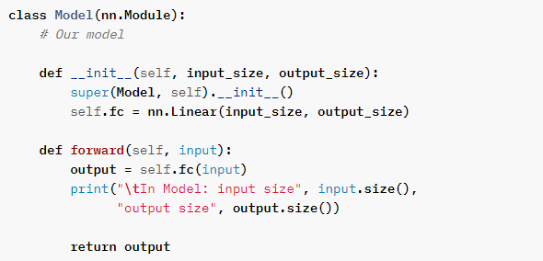
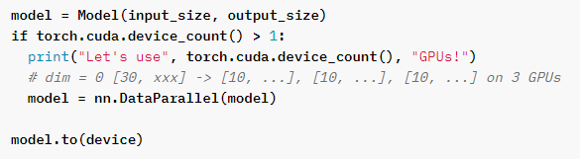
1.2.1 DataParallel (DP)
The DataParallel package enables single-machine multi-GPU parallelism with the lowest coding hurdle; only requires a one-line change.

Slide 11
1.2.1 DataParallel (DP)
Trading-off with simplicity, DP usually does not offer the best performance because
it replicates the complete model (i.e. updated model with gradients from all devices) in every forward pass,
and its single-process multi-thread parallelism naturally suffers from GIL contention.
NOTE : PyTorch officially NOT recommend using DP in production.

Slide 12
1.2.2 torch.distributed.elastic
DDP doesn’t provide Failure Recovery; e.g. from OOM or network timeout.
Failures in cluster cannot be handled using a standard try-except construct. This is because DDP requires all processes to operate in a closely synchronized manner;
More specifically, all All_Reduce communications in all processes must match (synchronized). = Exception in one of the processes causes desynchronization, resulting in cluster crash or hang.

Slide 13
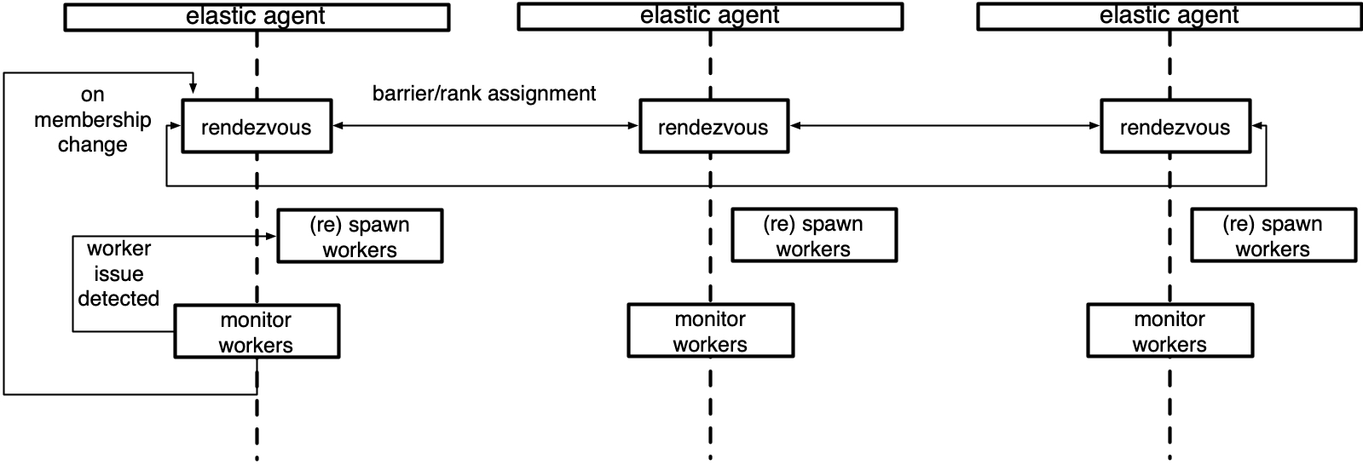
1.2.2 torch.distributed.elastic
Therefore, torch.distributed.elastic provides
Fault Tolerance/Handling for cluster
Dynamic pool of machines in cluster (Elasticity).
(Further explained in RPC-architecture)

Slide 14
1.3 Main Paradigms of Distributed/Parallel training
i.e. Higher level paradigm or architecture built upon PyTorch modules.
Data-Parallel Training (DP, DDP)
FSDP
RPC-based Distributed Trainings
Scalability, Flexibility, Customizability
Simplicity
DP
DDP
FSDP
RPC-based
Limited to Single Machine
Can extend to Multiple Machines
Can extend to large Cluster
Fully Customizable

Slide 15
1.4 Summary
Low Level
High Level
Components
DDP | RPC Backend | c10d library
Modules
 | Single Machine | Multiple Machines
Single GPU | Simple PyTorch | DDP + torchrun or torch.distributed.elastic.
Multiple GPU | DP or DDP
Paradigms
Data-Parallel Training (DP, DDP) | FSDP | RPC-based Distributed Trainings

Slide 16
2. Collective Communications
Collective Communications is to communicate across multiple processes in a cluster. c.f. Point-to-Point communication
There are 6 types of Collective Communications.
Terminology
All processes are in the World.
A Group is a subset of all processes.
Thus, multiple groups can reside in the World.

Slide 17
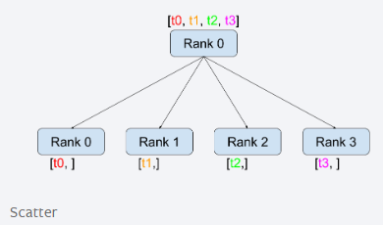
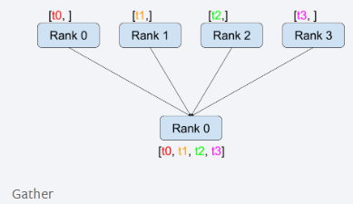
2.1. Scatter, Gather
Scatter dist.scatter(tensor, scatter_list, src, group)
Copies the i-th tensor scatter_list[i] to the i-th process.
Gather dist.gather(tensor, gather_list, dst, group)
Copies tensor from all processes in dst.

Slide 18
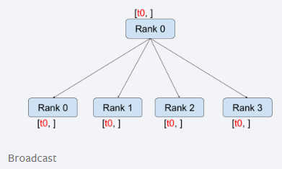
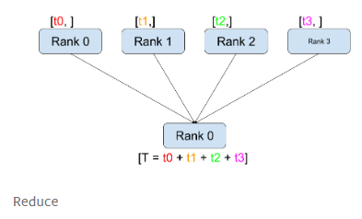
2.2. Broadcast, Reduce
Broadcast dist.broadcast(tensor, src, group) Copies tensor from src to all other processes.
Reduce dist.reduce(tensor, dst, op, group):
Applies op to every tensor
and stores the result in dst.

Slide 19
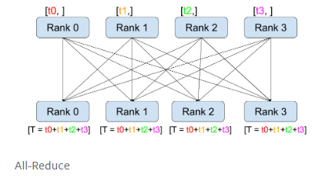
2.3. All-Reduce
All-Reduce dist.all_reduce(tensor, op, group)
Same as Reduce, but the result is stored in all processes.

Slide 20
2.3. All-Reduce
Implementation
All processes are individually communicating to each other. (Have O(N^2) communications )
Reduce to one process (Master) and master propagates back to all other processes. (Impose severe load on master process)

Slide 21
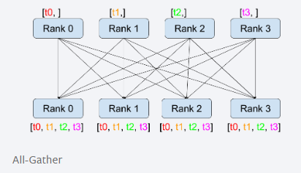
2.4 All-Gather
All-Gather dist.all_gather(tensor_list, tensor, group) Copies tensor from all processes to tensor_list, on all processes.
Simply, All-Reduce without op.

Slide 22
2.5 Notes
All-Reduce and All-Gather communications are Extremely expensive.
Thus, need to
decompose these ops into simple ops (Reduce, Broadcast, etc)
compute them distributely in parallel.
Thus, other strategies are proposed to solve such communication overload
e.g. Ringed All-Reduce in FSDP.

Slide 23
3. DDP
What is DDP
How DDP operates
Comparison to DP
Caveat of DDP
How to use DDP
DDP with Model parallelism
DDP with torchrun (Multi- Machines, Multi- Devices)

Slide 24
3.1. What is DDP
DDP implements data AND model parallelism which can run across multiple machines.
DDP can be run on both in
Single Machine - Multiple Devices
Multiple Machines - Multiple Devices
in which for latter, torchrun is required.

Slide 25
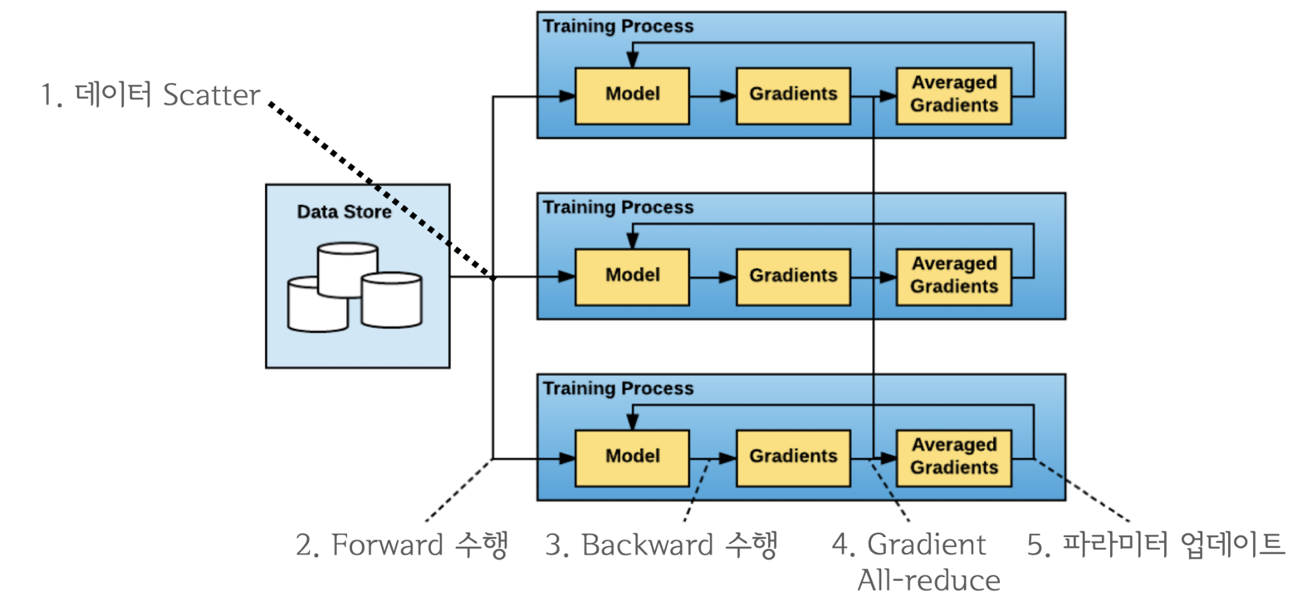
3.2 How DDP operates

Slide 26
3.2 How DDP operates
Specifically:
DDP registers an autograd hook for each parameter (in model.parameters())
The hook will fire when the corresponding gradient is computed in the backward pass.
Then DDP uses that signal to trigger gradient synchronization across processes.
Each process updates its own model with given (reduced) gradient.

Slide 27
3.3 Comparison to DP
 | DP | DDP
Mechanism | Single-process, multi-thread | Multi-process
Scaling | only works on a single machine. | works for both single- and multi- machine.
Parallelism | only Data parallelism | both Data and Model parallelism
For DP,
GIL contention deteriorates multi-threading performance
can’t scale on multiple machines
can’t train model with size larger than device.

Slide 28
3.3 Comparison to DP
Also, DDP wraps training jobs with Process, abstracting jobs from underlying devices.
This allows Heterogeneous composition of cluster.
In contrast, DP simply runs training on Thread, restricting to have Homogenous devices.

Slide 29
3.3 Comparison to DP
Even on a single machine, DP is slower than DDP because
GIL contention in multi-threading c.f. Multiprocessing is free from GIL
DP replicates full model per-iteration c.f. Only replicates gradients
and additional communication overhead introduced by
scattering inputs
gathering outputs.
c.f each machine contains own data.

Slide 30
3.4 Caveat of DDP - Skewed Processing Speeds
There are 3 distributed synchronization points in DDP:
Constructor
Forward pass
Backward pass
In ideal, each process would
launch the same number of synchronizations
and reach these synchronization points in the same order

Slide 31
3.4 Caveat of DDP - Skewed Processing Speeds
Although DDP is allowed to construct Heterogeneous cluster, DDP doesn’t provide delicate, flexible synchronization policy across processes.
Thus, fast processes might
arrive early
and timeout while waiting for slower processes. (# elastic)
Such skewed processing speeds can also be occurred by
Network delays
Resource contentions
or unpredictable workload spikes.

Slide 32
3.4 Caveat of DDP - Skewed Processing Speeds
Unlike elastic, DDP cannot recover from such timeout by itself.
Therefore, users are responsible for balancing workload distributions across processes.
Also, user must pass a sufficiently large timeout value when initializing training, so none of processes timeout to die.
Due to such inherent limitation of DDP, PyTorch recommends to use more advanced strategies for large clusters
e.g. FSDP, RPC-based architectures

Slide 33
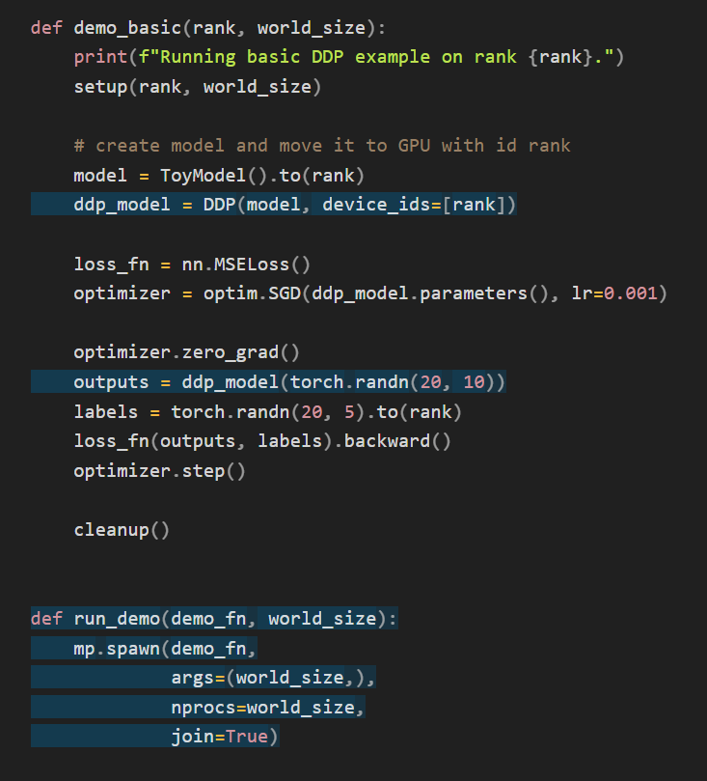
3.5 How to use DDP
To use DDP, simply wrap model with DDP, with device_id on which the process will run.
(rank is automatically passed by mp.spawn)
The recommended way to use DDP is to spawn one process for each model replica, where a model replica can span multiple devices.
(run_demo 1:1 maps processes to devices)

Slide 34
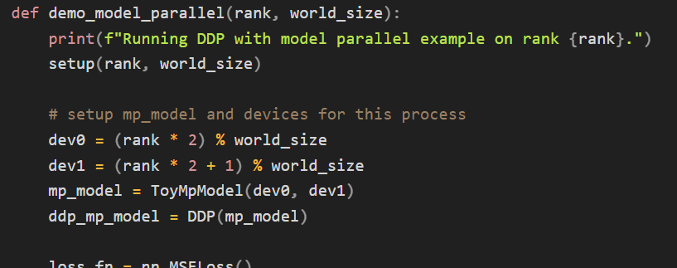
3.6 DDP with Model Parallelism
DDP with Model parallelism is the same as with Data parallelism, except device_ids and output_device must NOT be set.
They will be automatically set by forward() of the model or by the user/application.

Slide 35
3.6 DDP with Model Parallelism
However, although DDP supports Model parallelism, it is not efficient.
For example, DDP depends on All-Reduce / All-Gather to synchronize both Model and update gradients,
which are very expensive operation.
FSDP solves such inefficiencies of DDP for Model parallelism.

Slide 36
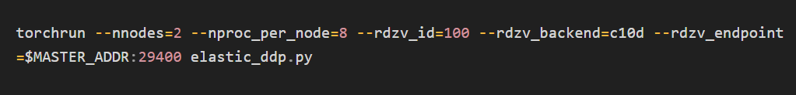
3.7 DDP with torchrun (Multi-machines, Multi-devices)
To initialize DDP jobs on all nodes in the cluster, run torchrun command: (elastic_ddp.py is same as previous examples)
meaning that DDP script is running on 2 hosts (nnodes) with 8 processes (nproc_per_node) for each.

Slide 37
3.7 DDP with torchrun (Multi-machines, Multi-devices)
However, to run this torchrun command across cluster, external Cluster management tools are required.
For torchrun, SLURM is the most commonly used tools.
e.g. srun --nodes=2 ./torchrun_script.sh
SLURM is Resource Management/Scheduling tools on Linux cluster.
Nvidia provides DeepOps, Infrastructure automation tools for Kubernetes and Slurm clusters with NVIDIA GPUs.

